Slide 1
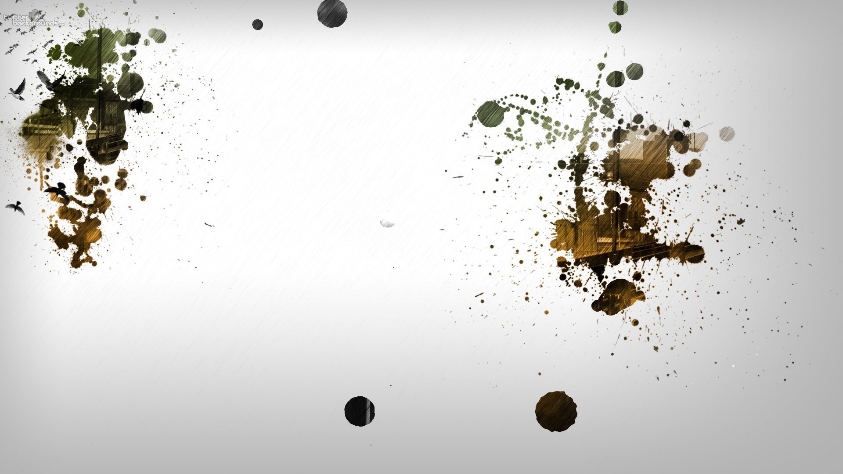

Computational Fluid Dynamics
Project by
Renat K & Shubham W
Title: Simulation of Tie Fighter

Slide 2
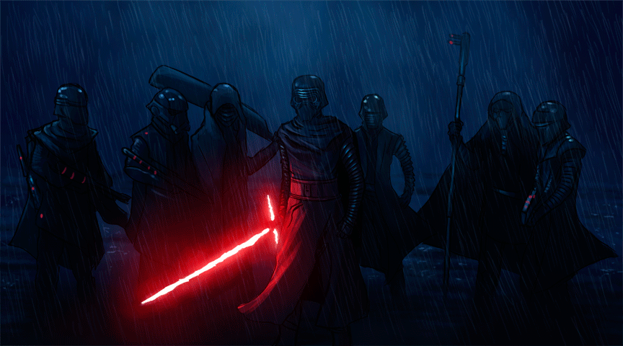
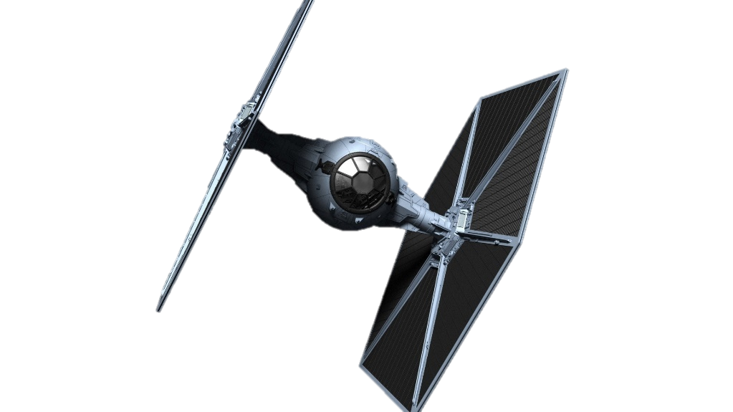
Objective
Can this thing Really fly in earth like environment
If yes can it create lift if Anti gravity fails
How draggy is this machine
And finally quenching our need for speed
Notes:
1. Objective of simulations was to verify and simulate flight mechanics of tie fighter particular to earth atmosphere.
2. Flight possibilities could be demonstrated if fighter provided lift with the help of lift forces generated by objects shape profile and sped alone.
3 drag is another parameter vital to any flying object, so its essential to check how much drag it produces at different speeds.
4 tie fighter is used in combat so higher speed tests are important, so we went up to 600 kmph. ( its less but its v good speed for small shaped ship)

Slide 3

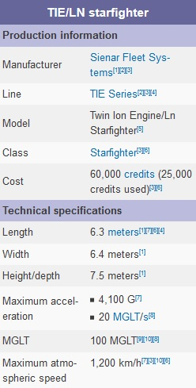
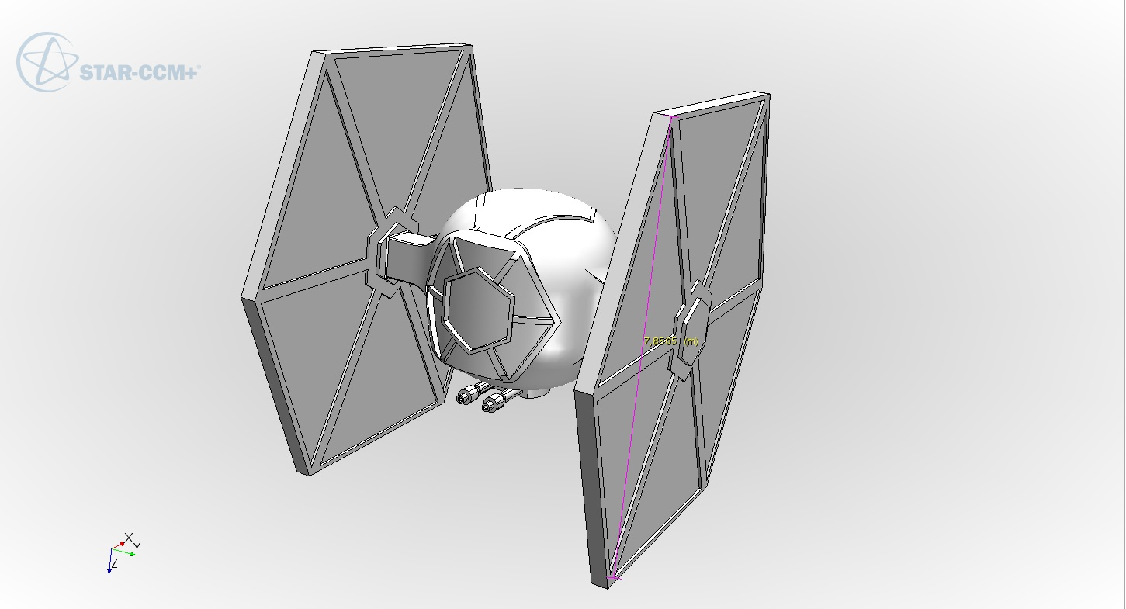
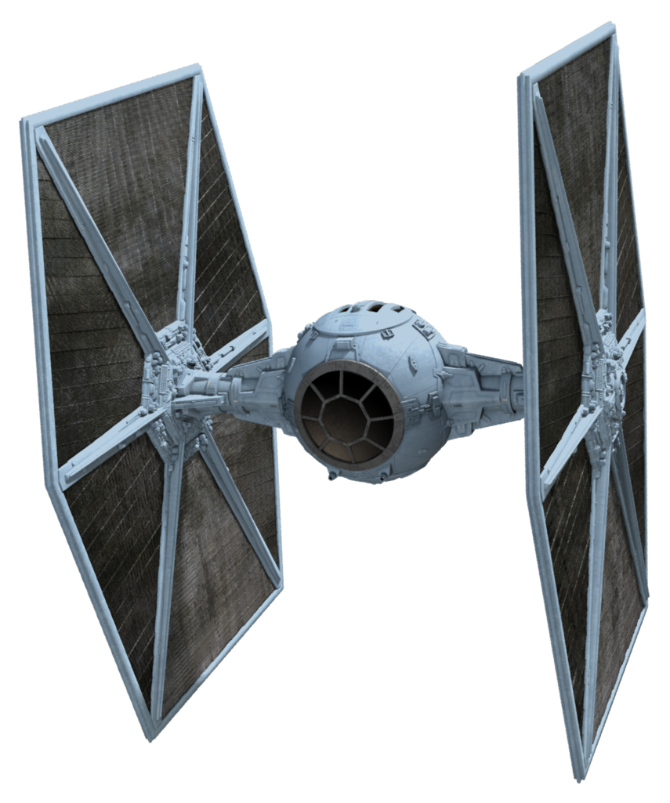
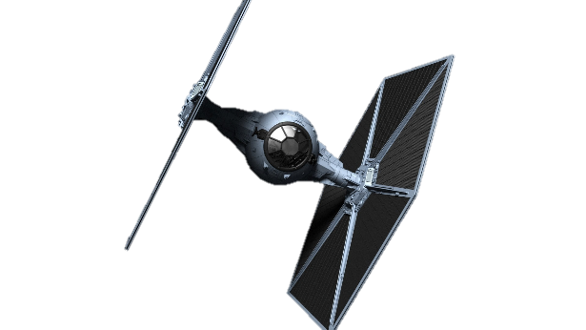
What is tie fighter
Scaling of model
Notes:
What is tie fghter: it is fighter used by rebellion forces, its strength is huge no of quantity and small size, they usually act in swarms to overwhelm enemies. Some of the technical specifications are given in slide above. Its flight mechanics is based on hypothetical anti gravity engine and super advance ion thrusters ( which are on middle part of the tie fighter). So starting with importing file and scaling it in required size is basic requirement, so it was done. However You can notice that core cockpit is bit larger in our simulation than original size. But we could not find much agreement over cockpit size.

Slide 4
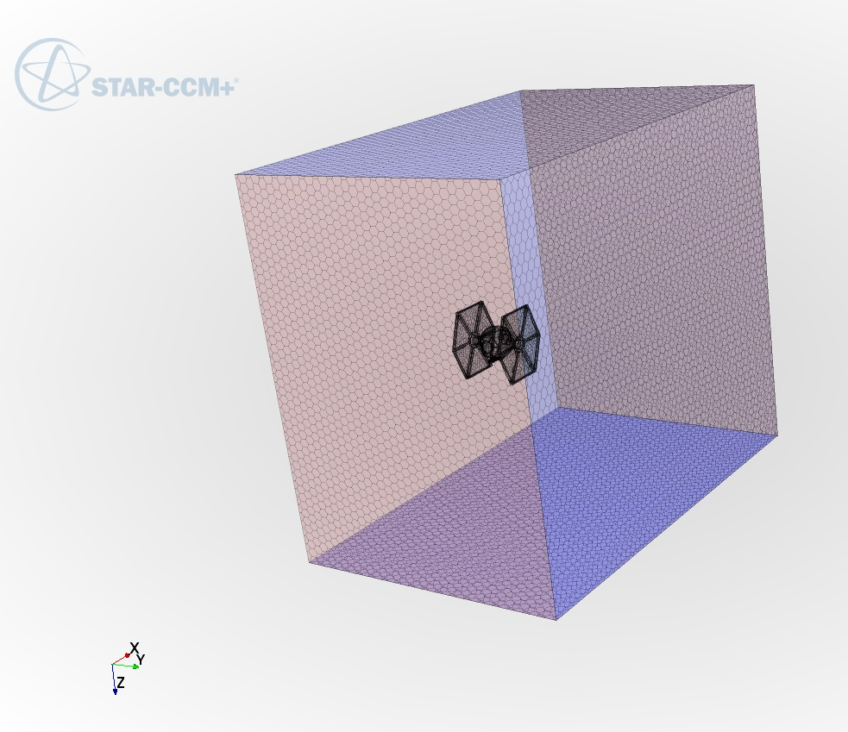
Generating Domain
Notes:
Domain was created approximately 25 metes on each side, and 30 m on rare side ( as it was area of most importance).
model selection: For physics model we used next modes: Three Dimensional, Gas, Steady, Segregated Flow, Gradients, Constant Density, Turbulent, Reynolds-Averaged Navier-Stokes, K-Epsilon Turbulence, Realizable k-Epsilon Two-Layer, two-Layer All y+ Wall Treatment
Turbulance etc.
> velocity inlet pressure outlet wall - Tie Fighter alll other - symmetry plane

Slide 5
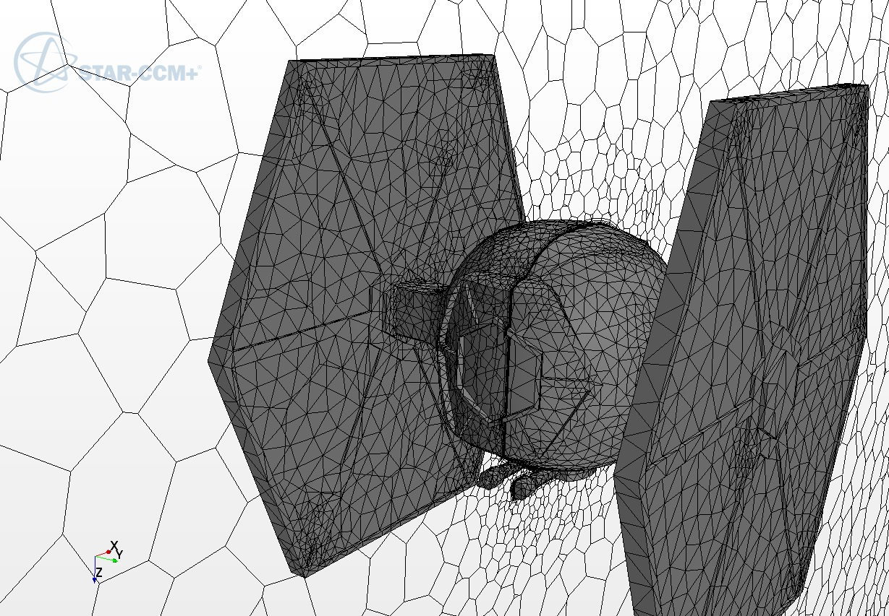
Meshing
Notes:
Meshing parameters:
Type of mesh: Bse size - 1 m Minimum surface size - relative size - 10 % Surface growth rate - 1.7 Number of prism layers - 9 Prism Layer Total Thickness - 10 % Volume growth rate - 1.7 Custom controls - surface control - values - Target surface size - relative size - 50 %
Surface wrapper: base size - 0.3 m minimum surface size - relative size - 10% custom control - Controls - relative value of Target surface size - 10%
Growth factor:
Percentage to base size:
Prism layers:

Slide 6
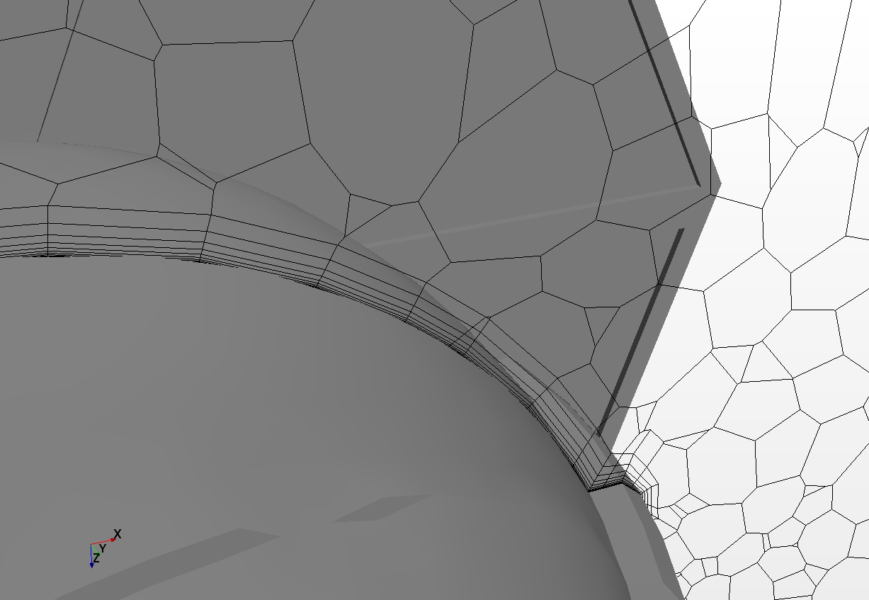
Prism layers

Slide 7
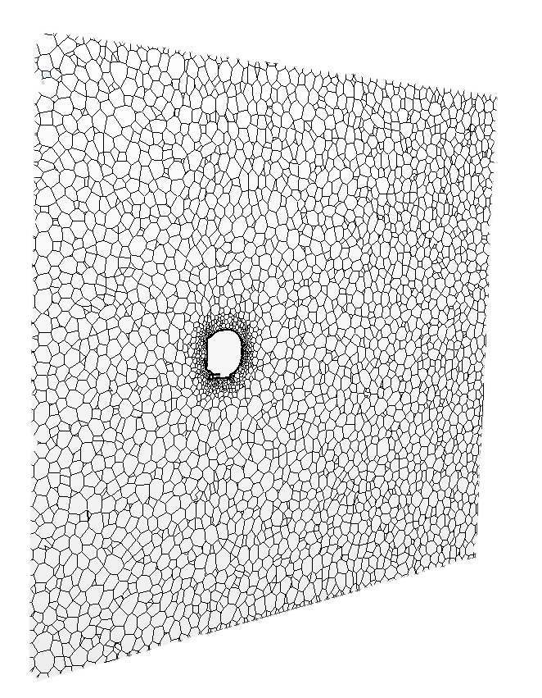
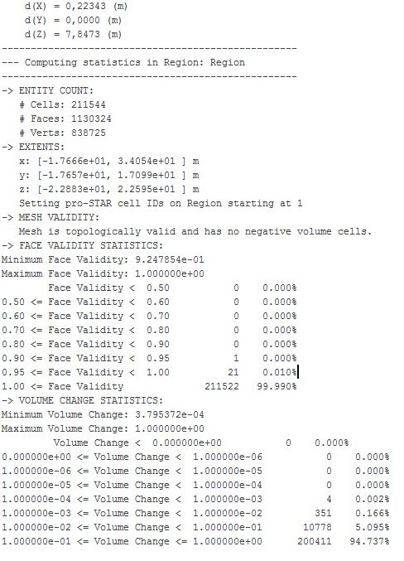
Quality mesh
Notes:
Reverifying mesh quality

Slide 8
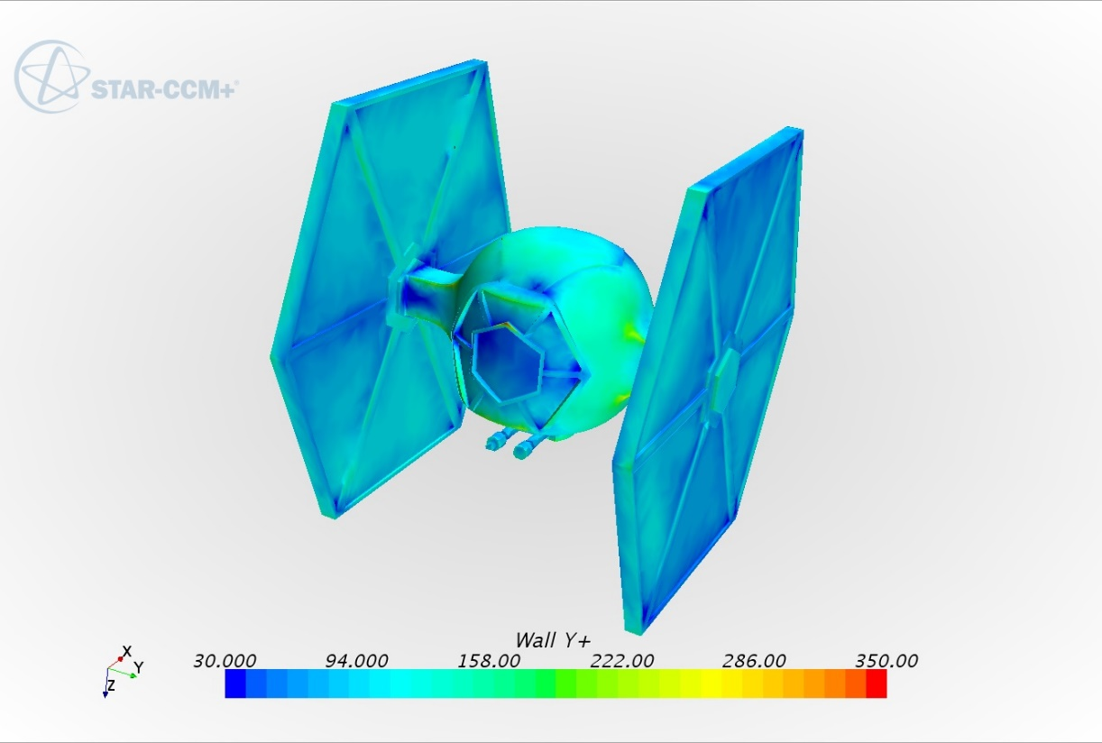
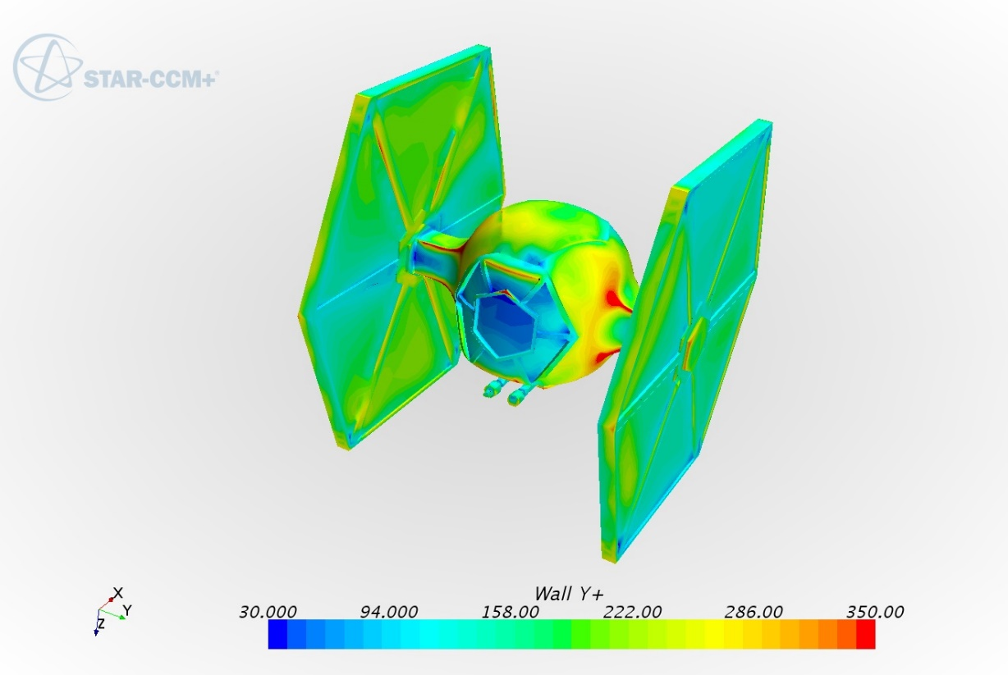
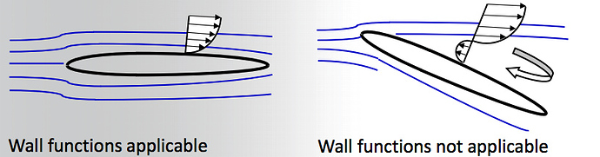
Checking Y+ wall
300 kmph
600 kmph
Notes:
y+ is a non-dimensional distance. It is often used to describe how coarse or fine a mesh is for a particular flow pattern. It is important in turbulence modeling to determine the proper size of the cells near domain walls. The turbulence model wall laws have restrictions on the y+ value at the wall.
y+=yuτ/ν

Slide 9
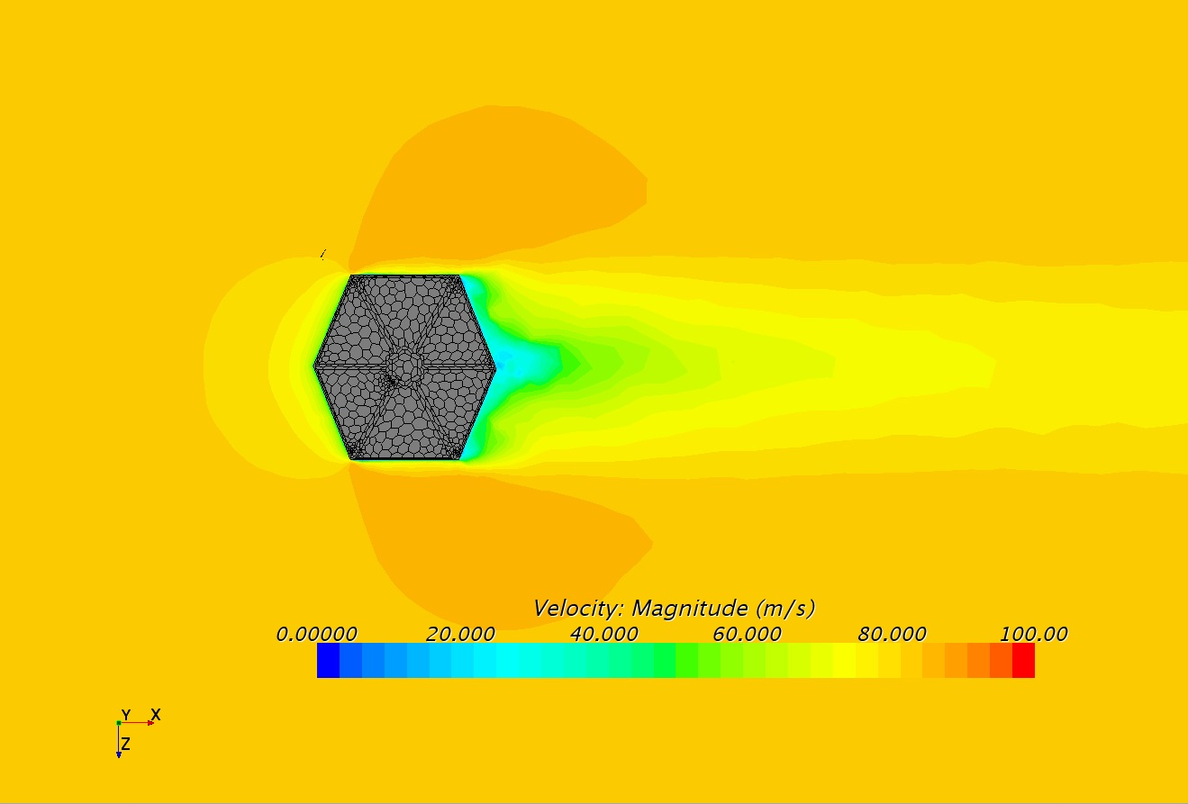
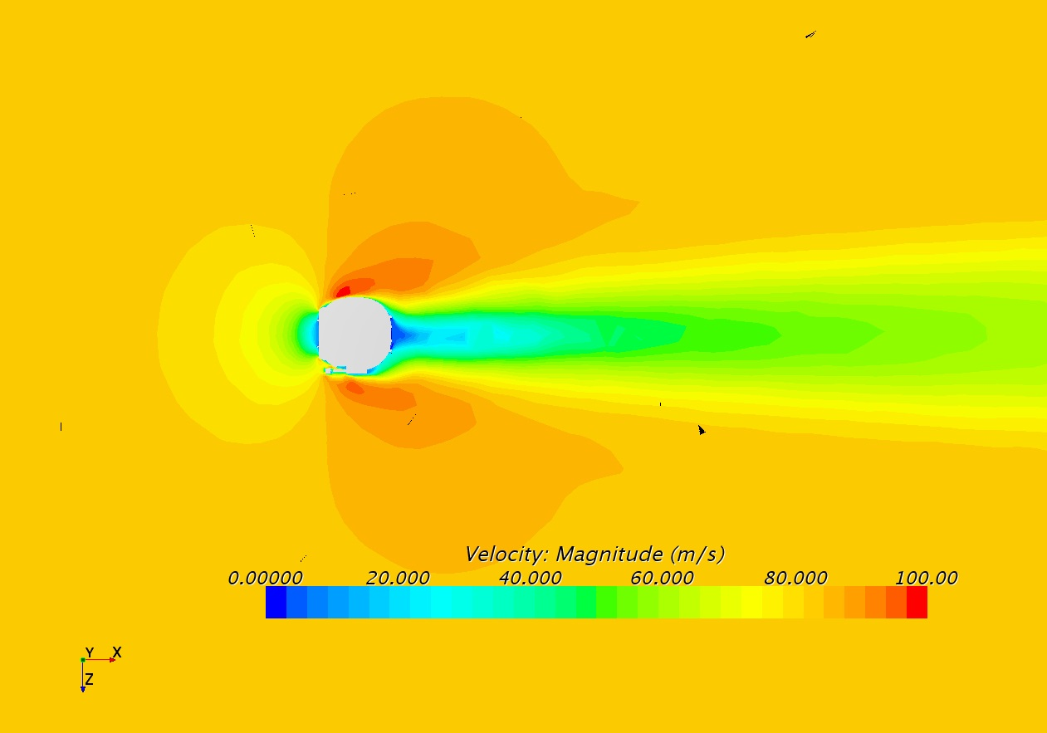
Velocity profile for 300kmph
Hexagonal solar panel plane
Middle plane

Slide 10

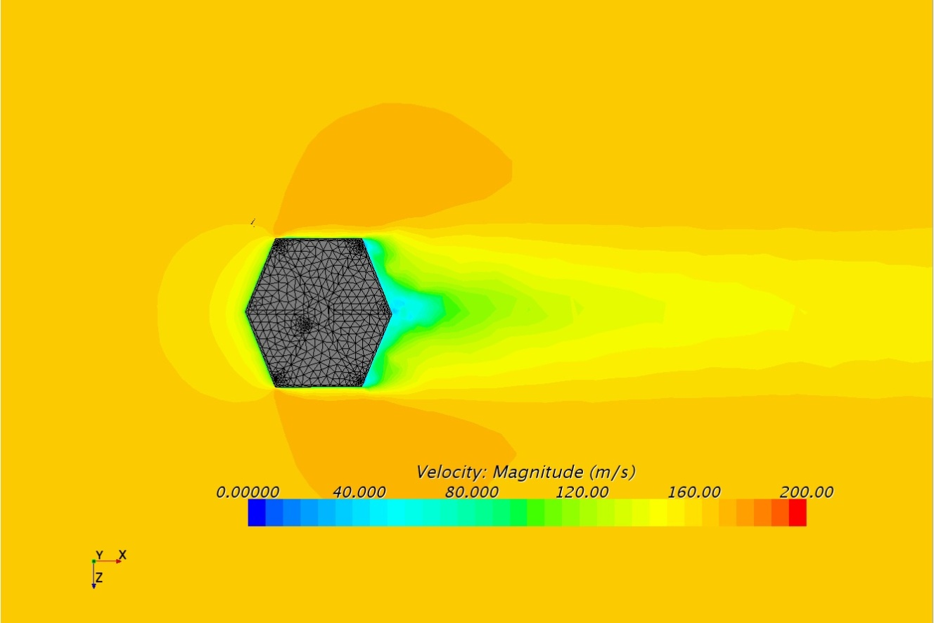
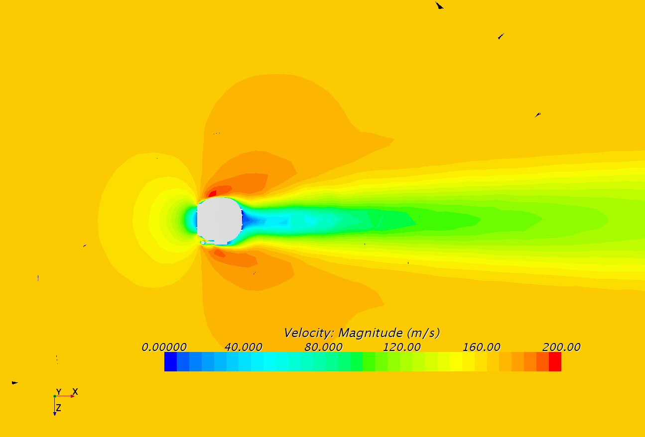
Velocity profile for 600kmph
Hexagonal solar panel plane
Middle plane

Slide 11
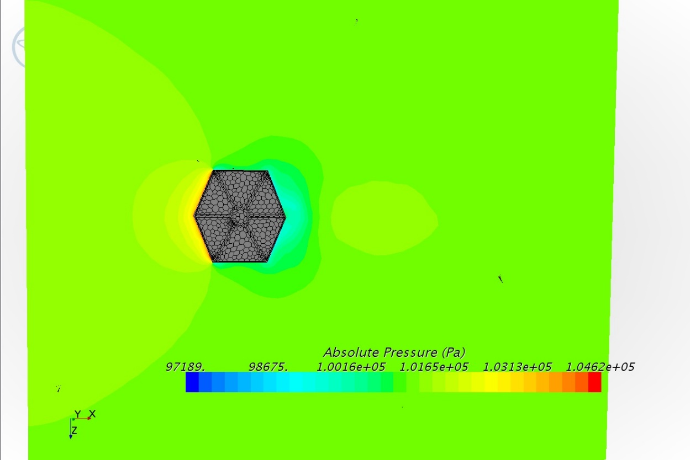
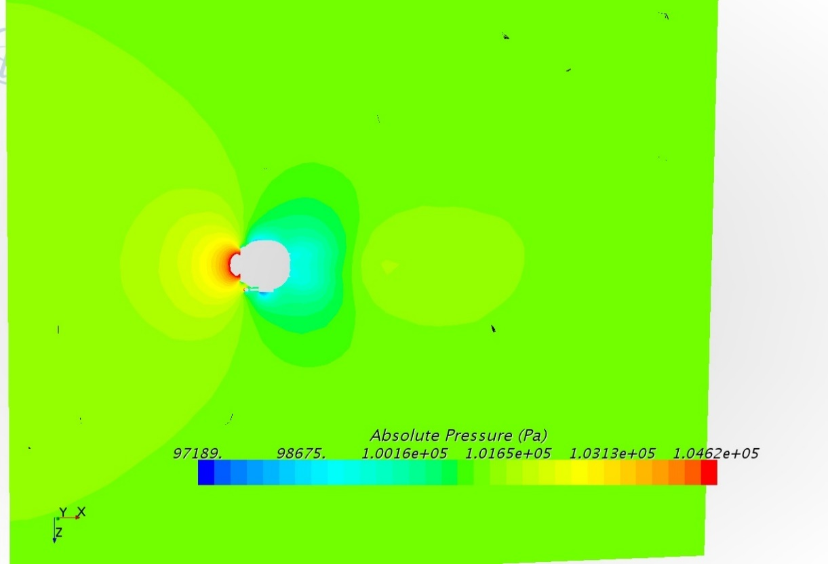
Pressure profile for 300 kmph
Solar panel plane
Middle plane

Slide 12
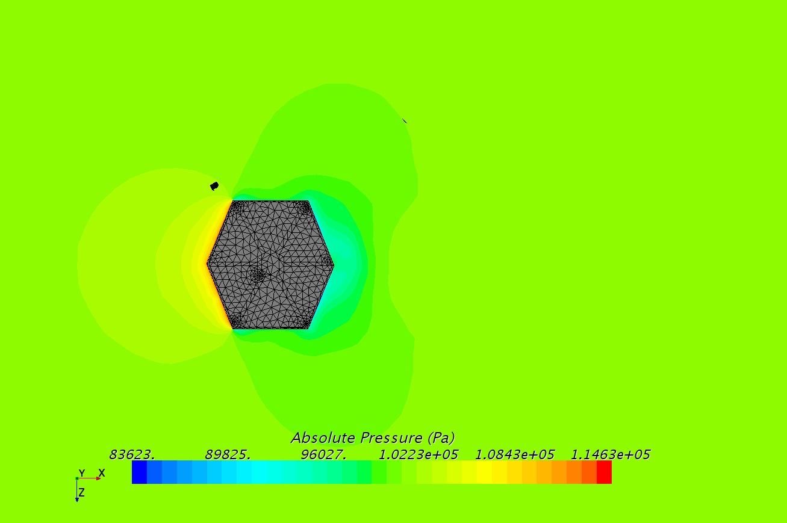
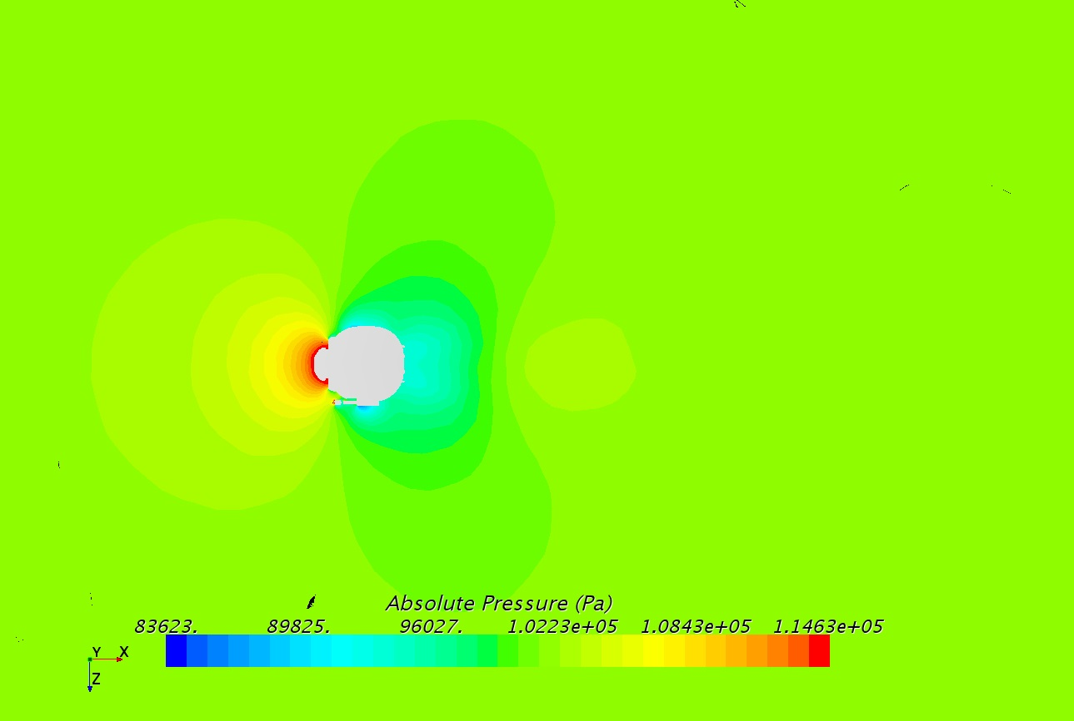
Pressure profile for 600 kmph
Solar panel plane
Middle plane

Slide 13
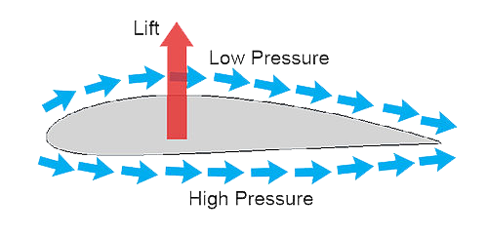
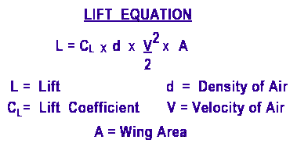
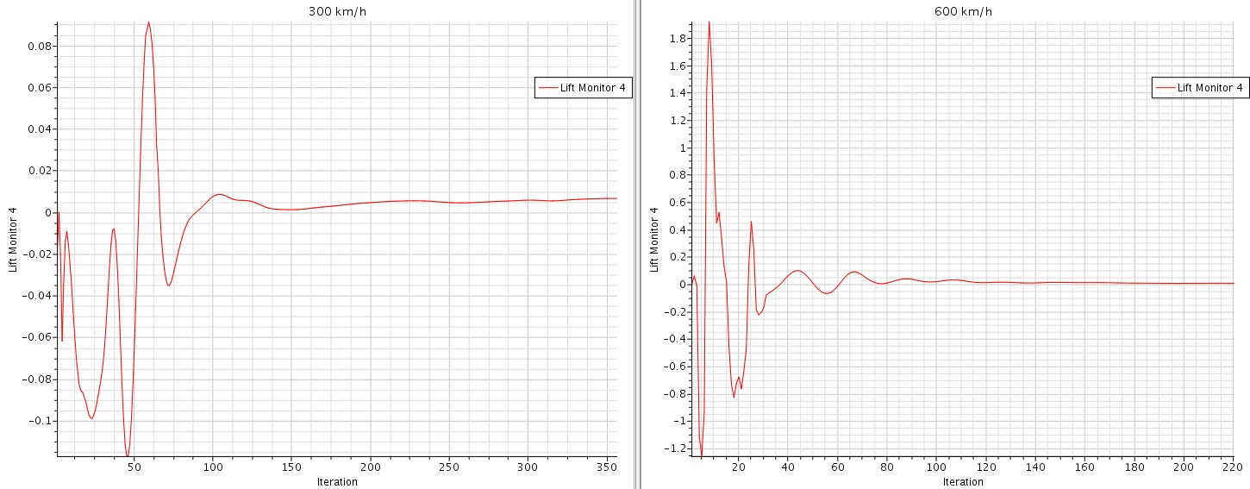
Lift force Comparison
CL = 0.0066
CL = 0.0070
Notes:
In mode 600 km/h lift forces on Z axe (to downside)) it's positive (but near 0) =0.007 Coefficient of drag forces = 5.14 in mode 300 km/h lift forces on Z axe (to downside)) it's positive (but near 0) =0.0066 (little bit lower) Coefficient of drag forces = 1.28 (much higher)

Slide 14
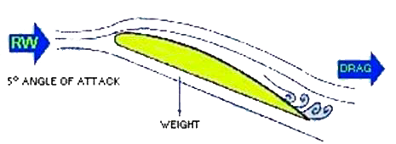
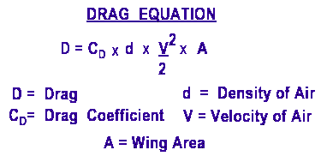
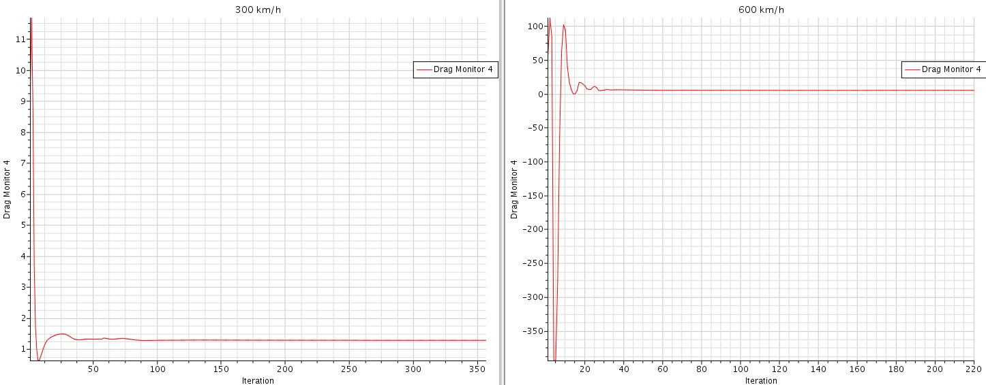
Drag force Comparison
CD = 1.28
CD = 5.14

Slide 15
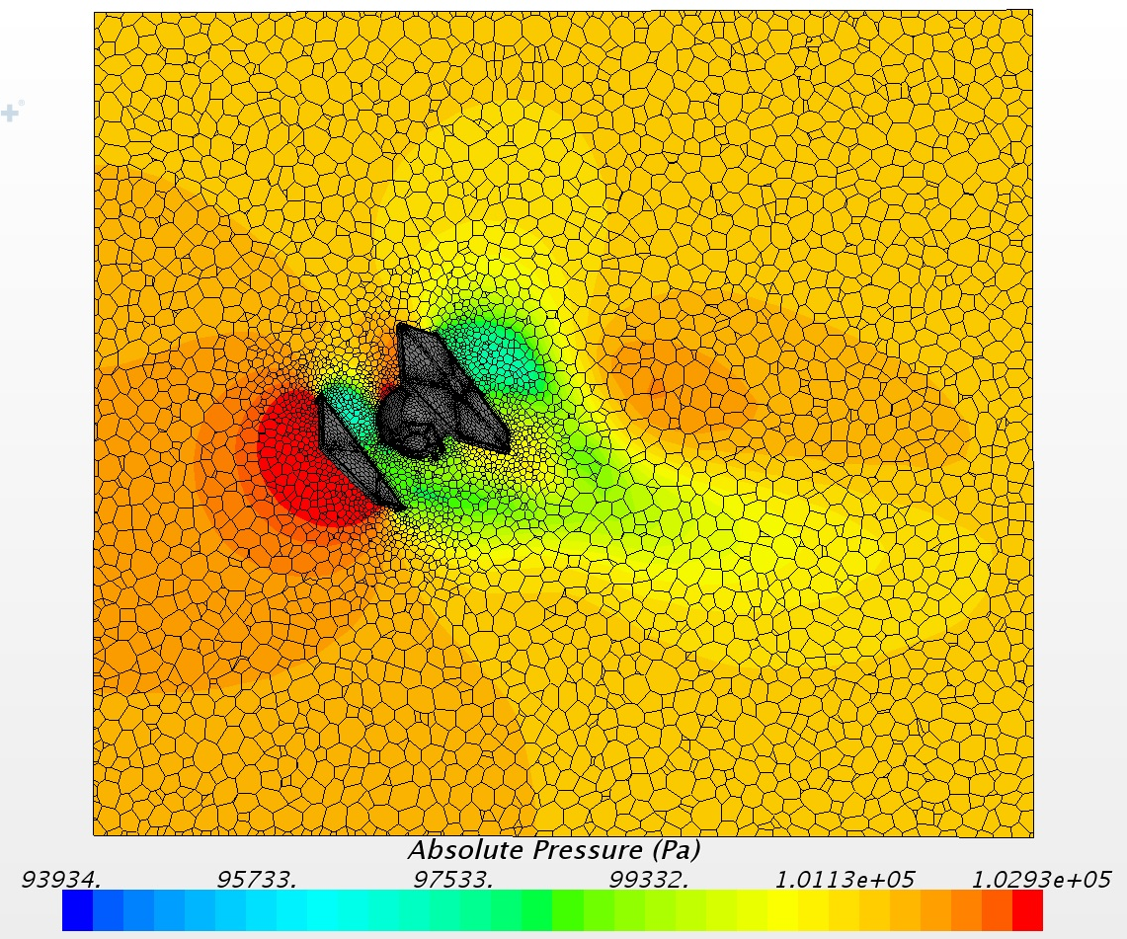
Impossible mode

Slide 16
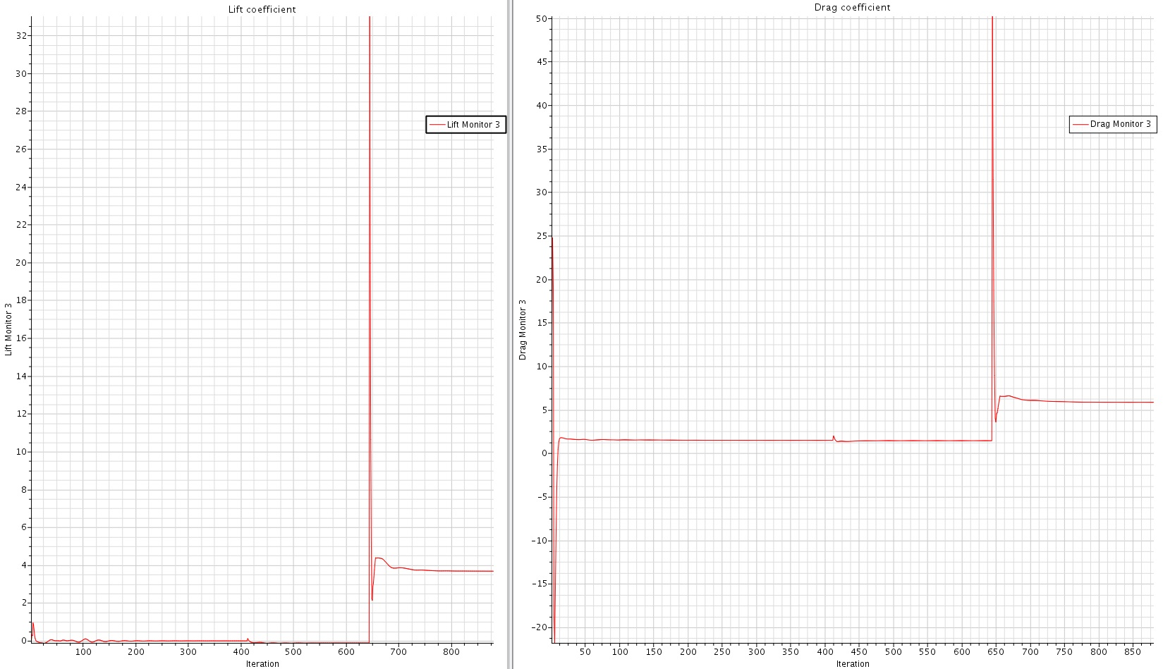
Impossible mode

Slide 17
Conclusion
Simulation shows that tie fighter has less to zero lift without anti-gravity assist
Also Simulation shows that tie fighter has squared relation drag for two simulated speeds of 600 and 300 kmph
Different Planet environment can be simulated by using deferent fluid than air, so to check
Viability of tie fighter on alien planets
No of cells of mesh can be further increased in order to get higher resolution near wall
No of prism cells and growth rate are the most important parameters to chose optimum simulation size.

Slide 18
Sources
Images used
https://bit.ly/2FODfeP
https://bit.ly/2FDm9kY
https://bit.ly/2RFZ8Ey
https://bit.ly/2U3xgXr
https://bit.ly/2RYFAun
https://bit.ly/2CAnQff

Slide 19

Thank You for Your Attention
Feel Free to ask Que.

